Slide 1
Lab 9 + PA 4
Sorting + Dijkstra’s
CS010C

Slide 2
Lab 9: Sorting
Testing the runtime of 3 sorting algorithms
Quicksort (pivot = midpoint)
Quicksort (pivot = median of 3)
Insertion Sort
Analyze actual runtime vs theoretical runtime

Slide 3
Lab 9: Starter Pack
void QPartition(int numbers[], int low, int high);
void Quicksort_midpoint(int numbers[], int i, int k);
void Quicksort_median(int numbers[], int i, int k);
void InsertionSort(int numbers[], int size);

Slide 4
Lab 9: Quicksort
Pivot value (median of 3 or midpoint)
Create low/high partitions
Recursively sort low and high partitions

Slide 5
Lab 9: Quicksort

Slide 6
Lab 9: Insertion Sort
Iterate through array
Create sorted and unsorted partitions
Insert number into correct position in sorted partition

Slide 7
Lab 9: Insertion Sort

Slide 8
Program 4: Jugs
2 jugs + infinite water source
Set of operations
Fill A, Fill B
Empty A, Empty B
Pour A B, Pour B A
Goal
0 gallons in A and N gallons in B
Output total cost

Slide 9
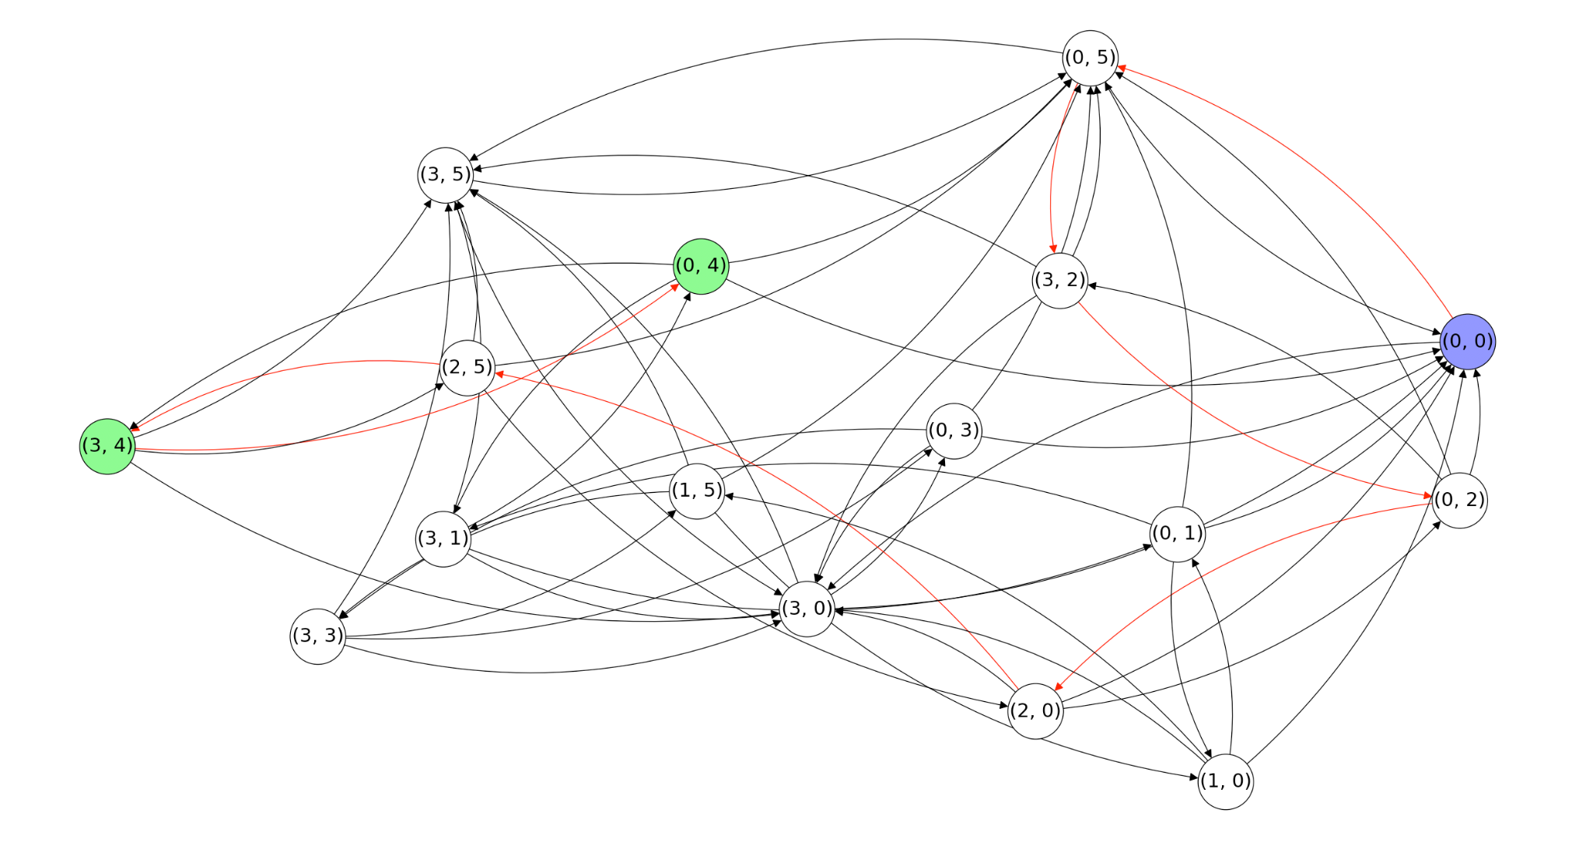
Program 4: Jugs

Slide 10
Program 4: Starter Code
state struct
State at every node (vertex in graph)
Vector of states becomes graph
Need to create graph and run Dijkstra’s
Need to output list of steps to obtain solution

Slide 11
Program 4: Dijkstra’s
Greedy algorithm (assumes positive edges)
Shortest path from node to all vertices
Initialize distances to infinity
Start vertex distance to be 0
For each adjacent vertex, compute distance to current + edge weight
If shorter then update and expand
Modified BFS
Use min heap to store nodes to expand

Slide 12
Thank you!
Questions?

